Slide 1
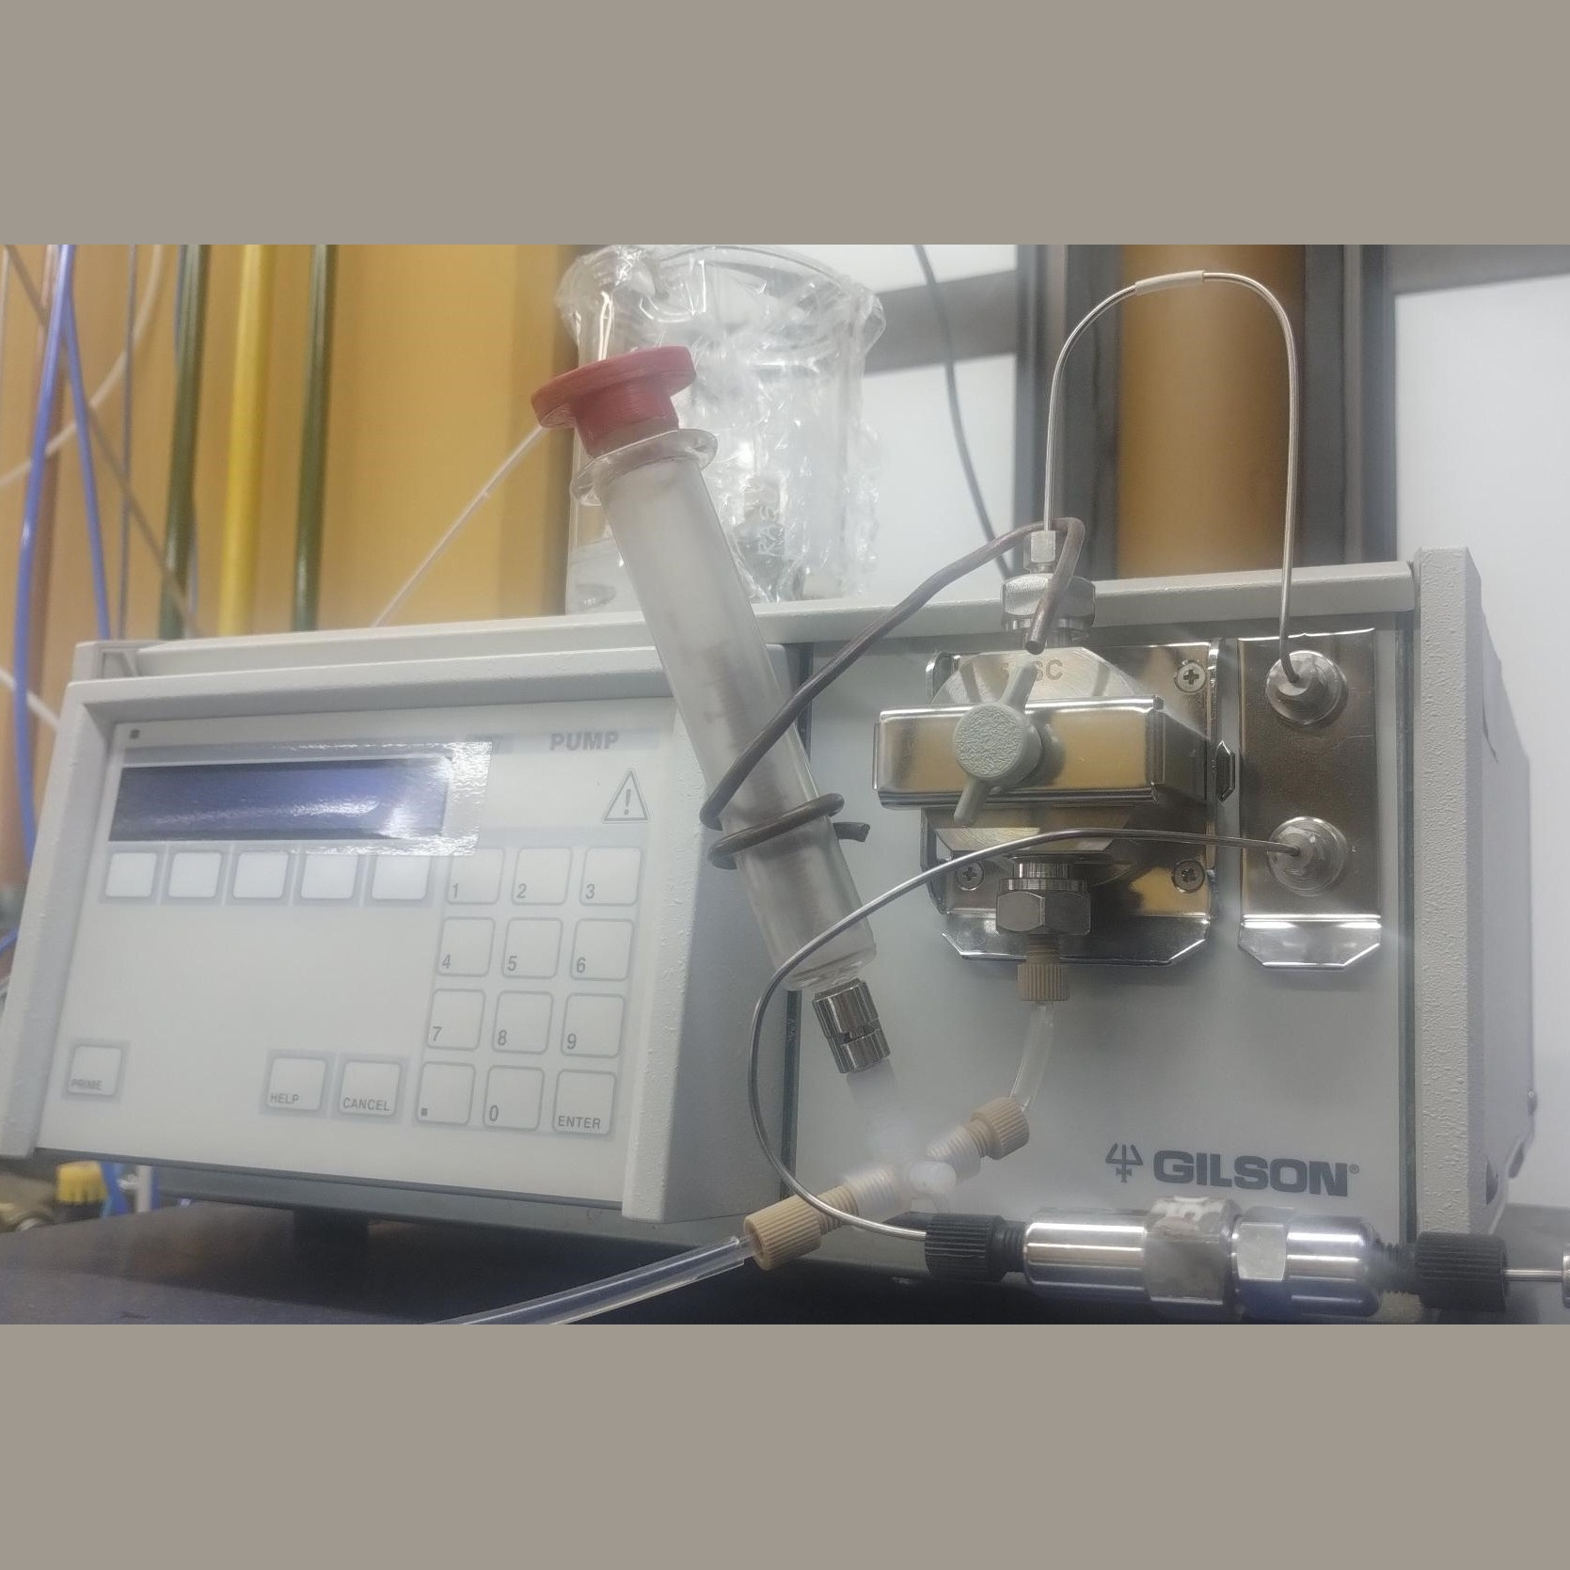
#5501
Fully programmable pump (5 sc/min) (GILSON, Model 307)
DESCRIPTION
Programmable, constant-stroke, single-piston interchangeable head reciprocating pump with rapid filling motion, internal pulse dampener, and pressure feedback.
MAIN FEATURES
Pressure: 0.1–60 MPa (600 bar)
Flow rate: 0.010–5 ml/min
Head: 5 SC
Accuracy: <±1% or 0.1 Mpa
Repeatability: <1% or 0.1 MPa
Isocratic operation mode with constant solvent flow
MAIN APPLICATIONS
Precise and reproducible control of liquid flow in research experiments
Solvent pump in high-pressure liquid chromatography (HPLC) systems
Low-speed liquid dosing with high precision in laboratory processes
ASSOCIATED CAPABILITIES AND SERVICES
2502, 2504, 3501, 3502

